Slide 1

Pressure Transducer Options

Slide 2
Original Model: HSCDRRN010ND2A3
HSC: High accuracy, compensated/amplified
D: Dual Inline Pin
RR: Dual radial barbed ports (same side)
N: Dry gases only, no diagnostics
010ND: +/- 10 in H2O (differential)
2: I2C, Address: 0x28
3: 3.3 V supply

Slide 3
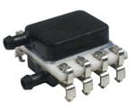
Option 1: HSCMRRN010ND3A3
M: Surface mount
3: Address: 0x38
45 In Stock
$68.58 single
https://www.mouser.com/ProductDetail/Honeywell/HSCMRRN010ND3A3?qs=4indQ9AG%252BqFEBM8FHk5y4Q%3D%3D

Slide 4
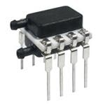
Option 2: HSCDRRN010ND3A3
3: Address: 0x38
3 In Stock
$67.40 single
https://www.mouser.com/ProductDetail/Honeywell/HSCDRRN010ND3A3?qs=FIB5FJLAMZP1eeoK7gBavg%3D%3D

Slide 5
Option 3: HSCDRRD010ND7A3
N: Dry gases only, diagnostics on
May reduce need for redundant sensors in system
Detects most internal failures including burst sensors
7: Address: 0x78
44 In Stock
$69.09
https://www.mouser.com/ProductDetail/Honeywell/HSCDRRD010ND7A3?qs=FiQKt8VsdiDajtOBIMIbrg%3D%3D

Slide 6
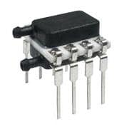
Option 4: OMO Electronic Components
Same model number
202 In Stock
Price? Credibility?
https://www.omo-ic.com/chip/2ee/HSCDRRN010ND2A3.html

Slide 7
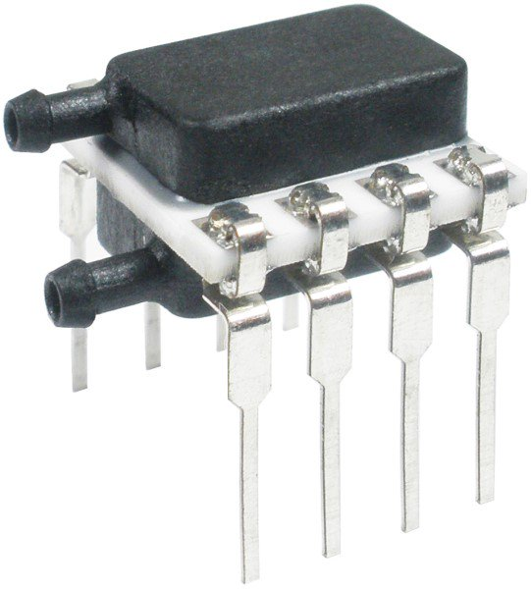
Option 5: HSCDRRN010ND7A3
15 In Stock
$66.18 single
https://www.onlinecomponents.com/honeywell/hscdrrn010nd7a3-48159372.html?utm_campaign=findchipsFeed&utm_medium=inventoryrefferal&utm_source=findchipsFeed
Notes:
https://www.masterelectronics.com/honeywell/hscdrrn010nd7a3.html?p=48159372&utm_medium=buyNow&utm_source=supplyFrame
https://www.verical.com/pd/honeywell-unsorted-HSCDRRN010ND7A3-5817032?utm_campaign=verical_oems_2019&utm_medium=aggregator&utm_source=oemstrade&utm_content=inv_listing

Slide 8
Option 4: HSCDRRN010ND4A3
3: Address: 0x48
1 In Stock
$45.65 single
https://www.mouser.com/ProductDetail/Honeywell/HSCDRRN010ND4A3?qs=FIB5FJLAMZNyFlySGQ9ReQ%3D%3D

Slide 9
Option 5: HSCDRRN010ND5A3
5: Address: 0x58
1 In Stock
$45.65 single
https://www.mouser.com/ProductDetail/Honeywell/HSCDRRN010ND5A3?qs=FIB5FJLAMZPVVehD0R4WnA%3D%3D

Slide 10
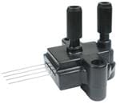
Option 6: HSCSNBD010ND3A3
S: Single inline pin
NB: Fastener mount, dual axial ports, same side
D: Dry gases only, diagnostics on
1 In Stock
$67.84 single
https://www.mouser.com/ProductDetail/Honeywell/HSCSNBD010ND3A3?qs=q%252BYTWua2SURQbWZhtBrz3Q%3D%3D

